Slide 1
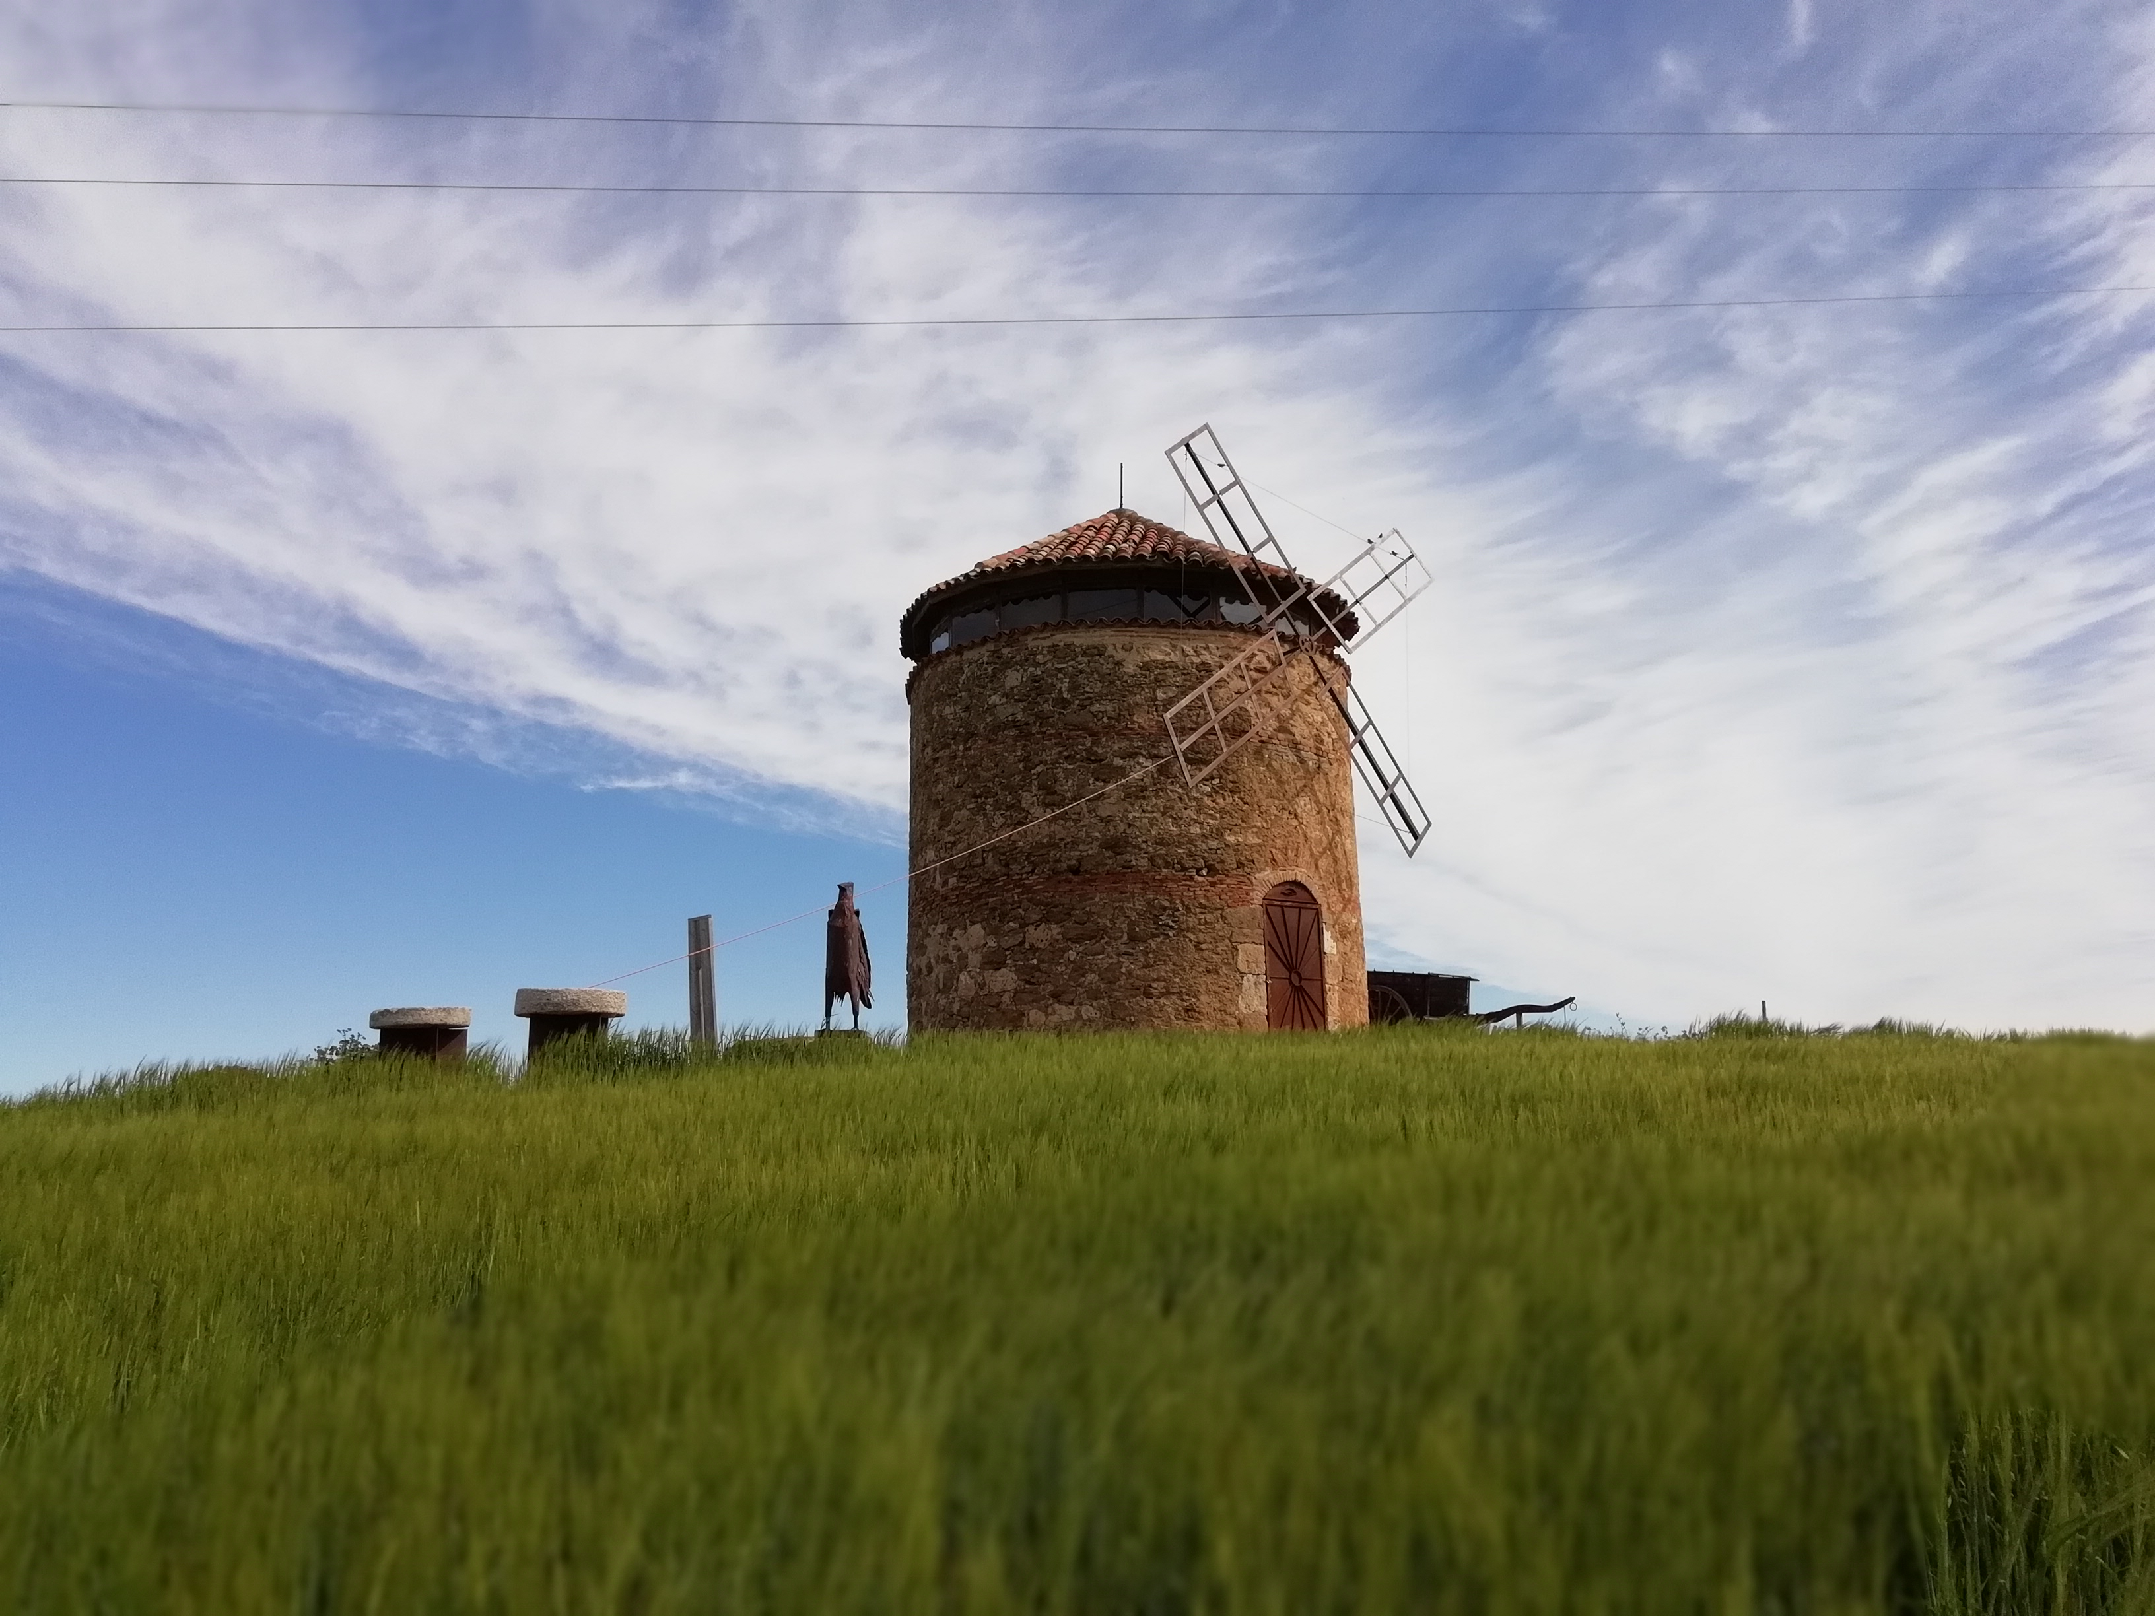
Modelling the Relationship Between Wind Energy Generation and Energy Intensity in Spain’s Autonomous Communities
Eric hausken-brates — July 2024
Master Thesis — UC3M Computational Social Science
By Marta Esther Vázquez Fernández - Own work, CC BY-SA 4.0,

Slide 2
Agenda
Eric hausken-brates — July 2024
How are wind and energy intensity related?
Initial Hypothesis
Models
Significant predictors of EI
Hypothesis assessment
Recommendations for policymakers
By Marta Esther Vázquez Fernández - Own work, CC BY-SA 4.0,

Slide 3
Why Spain 🇪🇸?
Why wind 💨?
Eric hausken-brates — July 2024
My background
Spanish history as world leader
Importance for other countries
By Marta Esther Vázquez Fernández - Own work, CC BY-SA 4.0,
Notes:
I worked for an energy company (P Gas&Electric) before and became very interested in looking up energy data. I read that Spain has long history with wind energy. But it all stopped growing after the great recession when Spain was going through a tough economic time. Before 2013, there was lots of growth in wind farms, but then it stopped and then did not grow until 2019. In that time, coal had decreased and overall energy consumption and generation stalled.

Slide 4
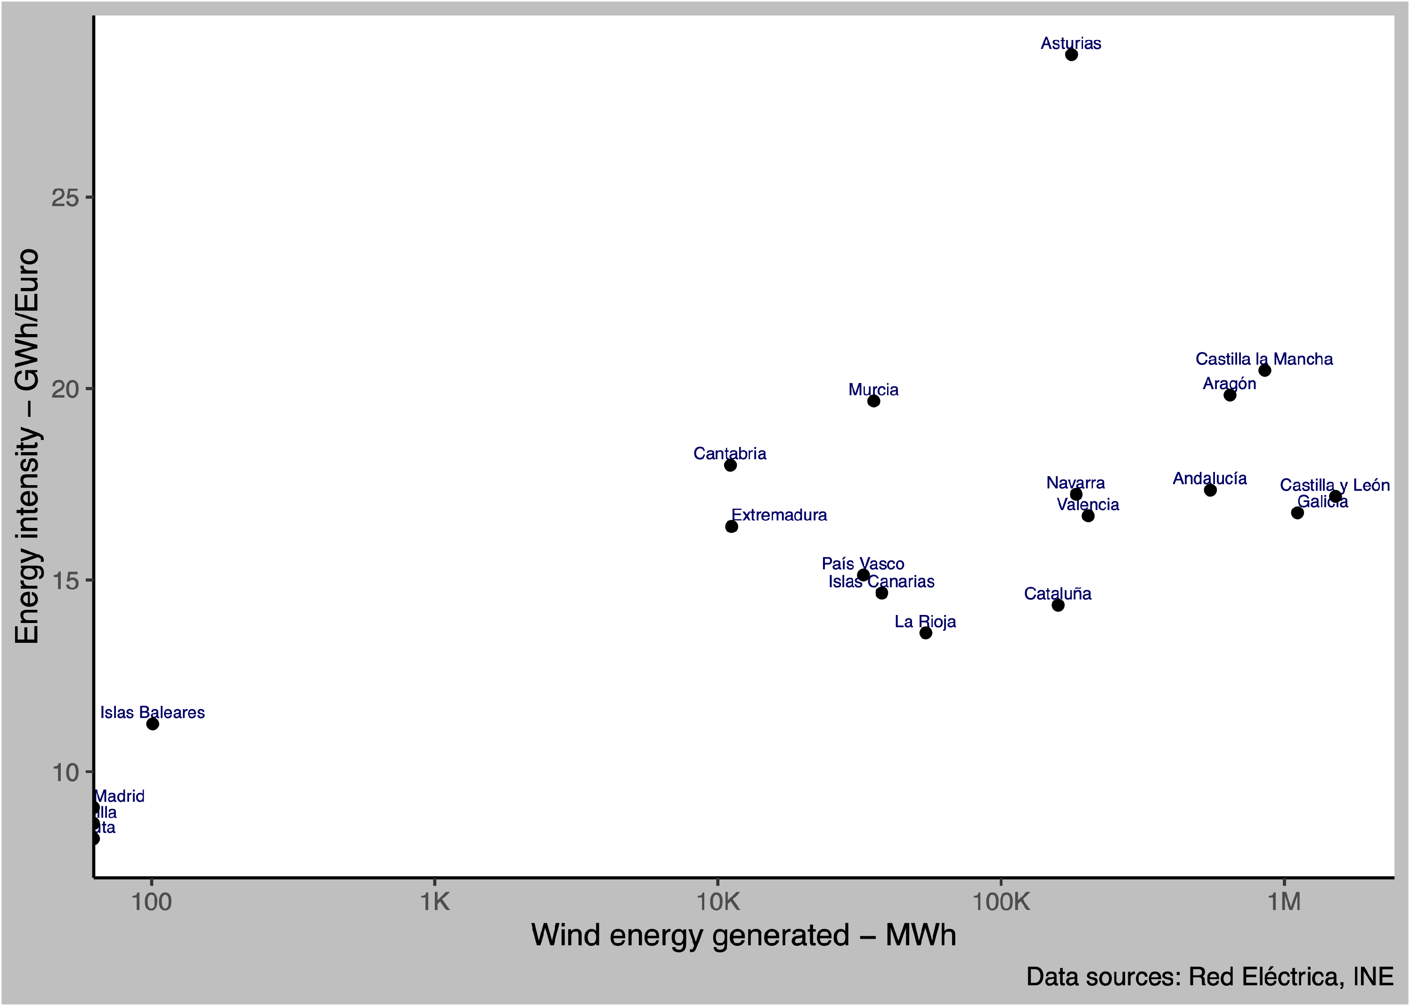
EI = MWh / GDP
Eric hausken-brates — July 2024
Energy consumption per economic production
Measures efficiency in the economy
Lots of available data
Positive correlation with wind energy in Spain’s CCAA
By Marta Esther Vázquez Fernández - Own work, CC BY-SA 4.0,

Slide 5
Jevon’s Paradox describes backfire effect despite tech advancements
Eric hausken-brates — July 2024
When people consume more because of more availability
Structural vs. Efficiency advancements
Works Cited:
Cansino et al., 2019
Haas & Kempa, 2018
By Marta Esther Vázquez Fernández - Own work, CC BY-SA 4.0,

Slide 6
Eric hausken-brates — July 2024
By Marta Esther Vázquez Fernández - Own work, CC BY-SA 4.0,

Slide 7
Eric hausken-brates — July 2024
Hypothesis/ Research question

Slide 8
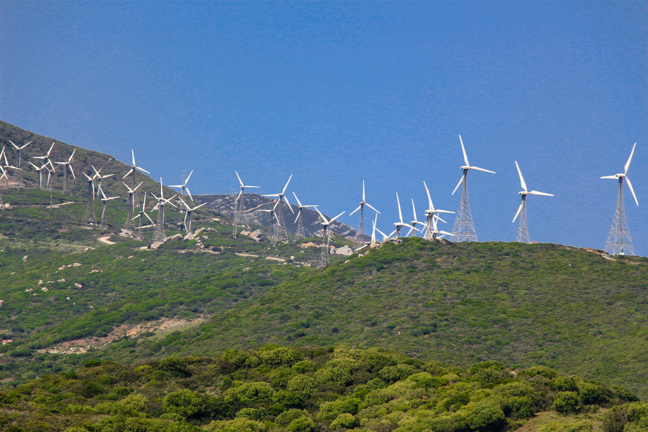
An increase in wind energy ↗️
Eric hausken-brates — July 2024
Hypothesis/ Research question
is associated with a
decrease in energy intensity ↘️
within a region.

Slide 9
A) Seasonal changes🗓️
Eric hausken-brates — July 2024
Hypothesis/ Research question
B) Regional differences 🗺️

Slide 10
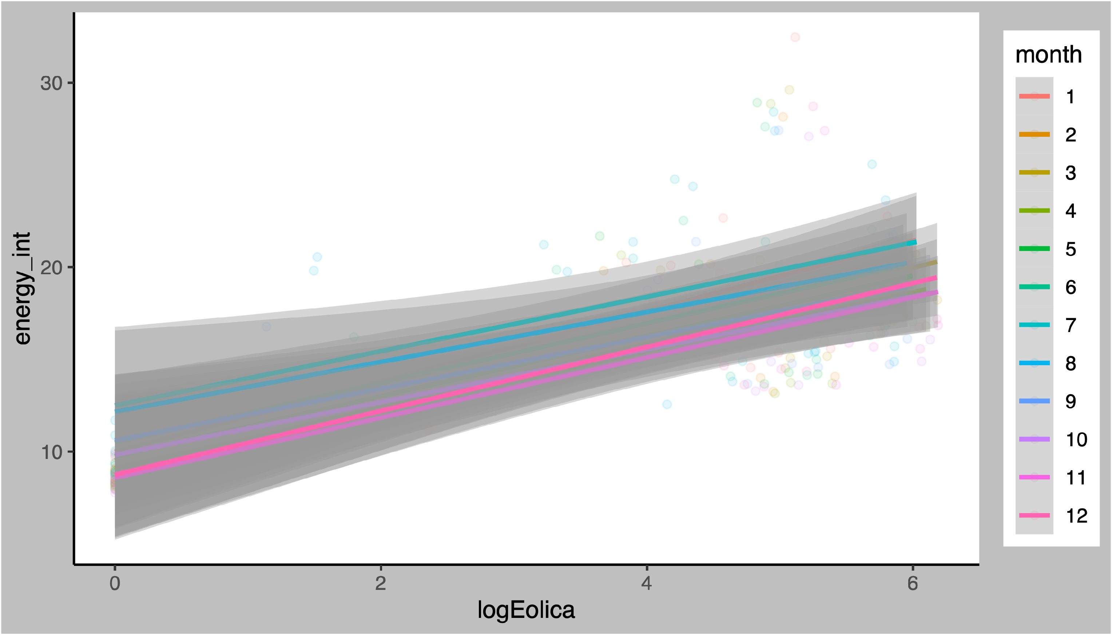
Month not a significant covariate by itself
Eric hausken-brates — July 2024

Slide 11
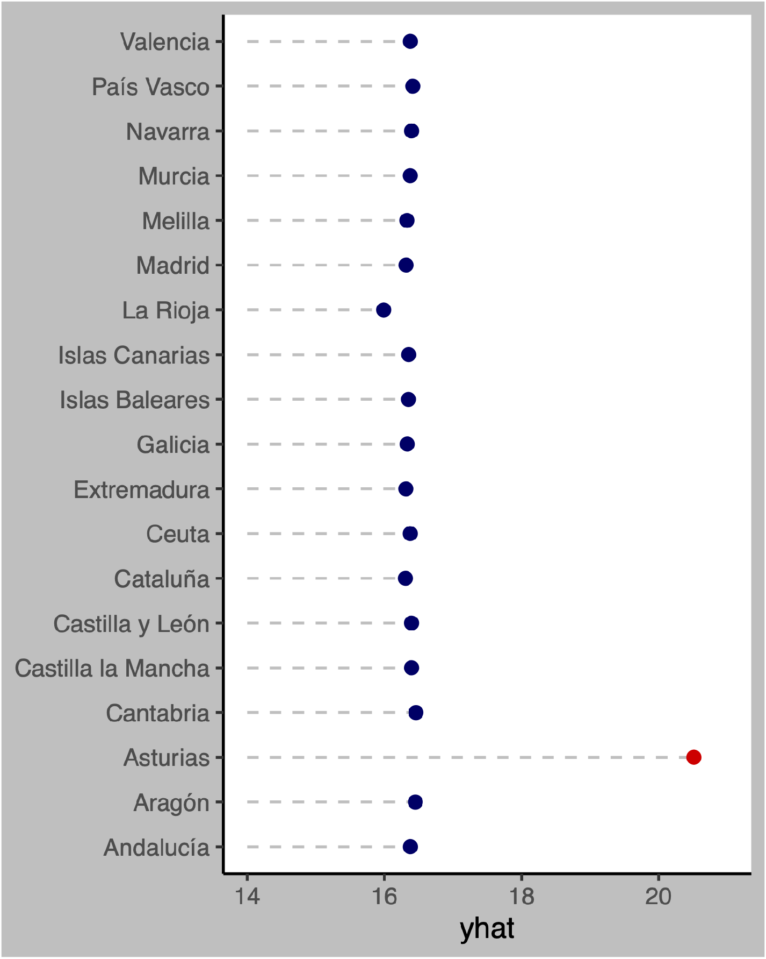
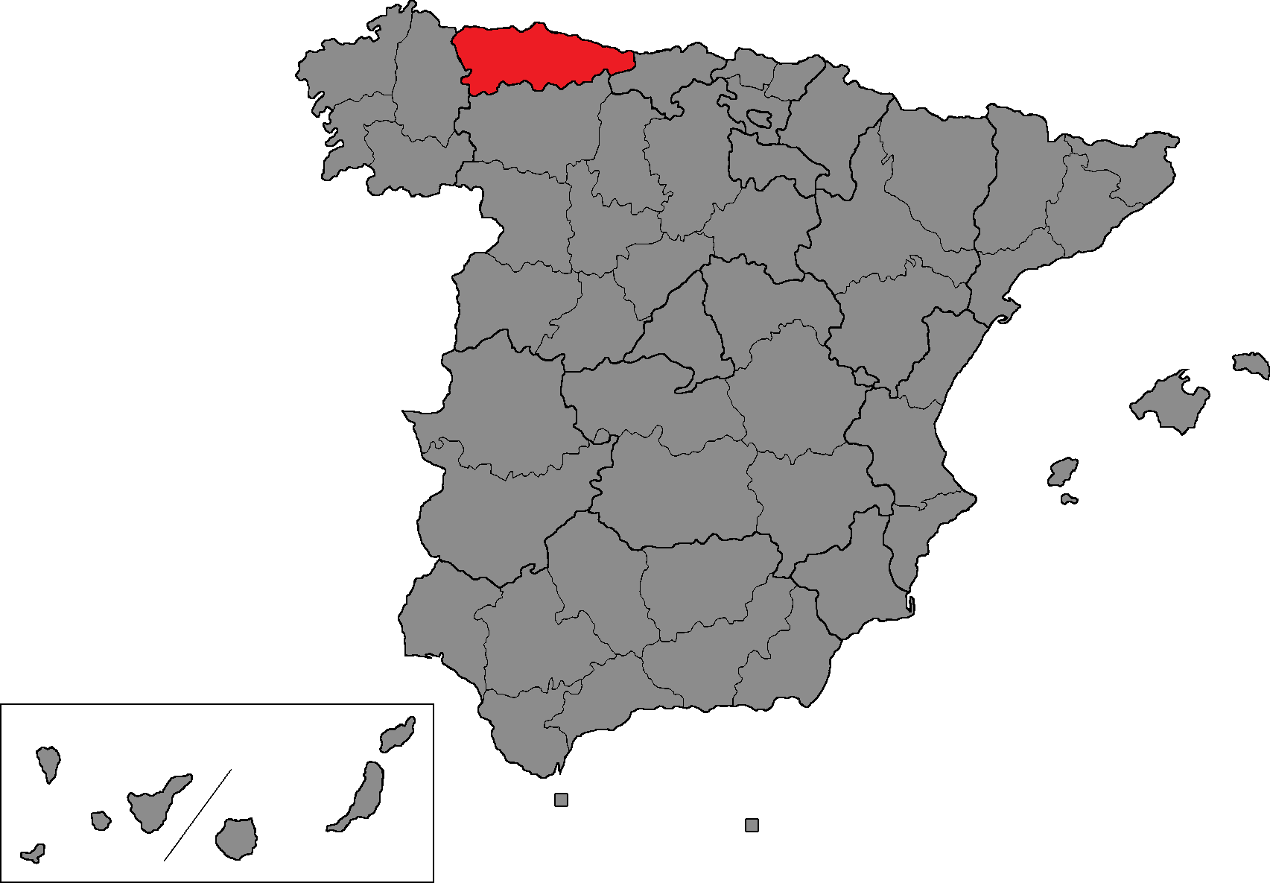
Asturias a significant predictor of EI
Eric hausken-brates — July 2024
By Impru20 - Own work, CC BY-SA 4.0
Notes:
Random forest `yhat`. The model results showed that CCAA was an important predictor. Specifically, it was important when looking at Asturias. For the other CCAA, the models don’t deem them important and don’t care. I removed all the CCAA except for Asturias in my reduced RF model and the model was just as good.

Slide 12
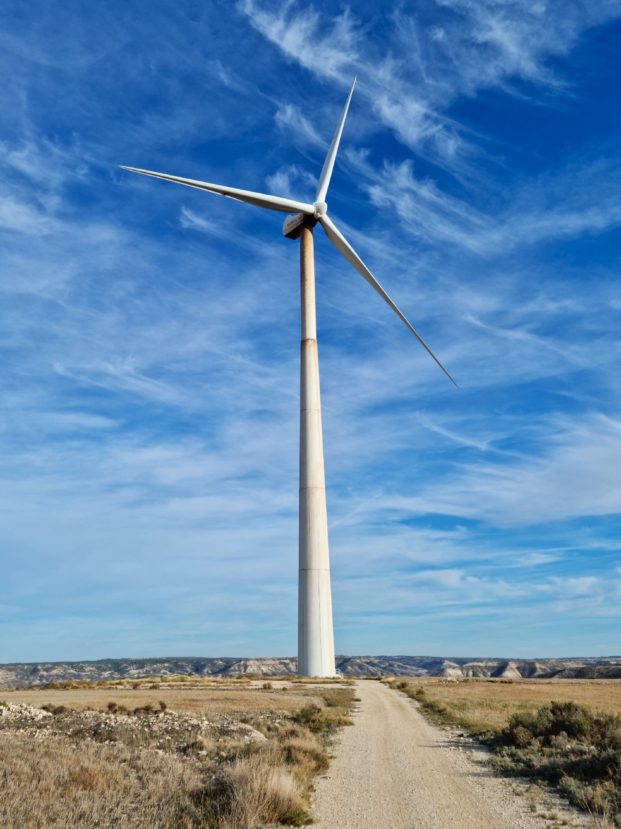
Models used to test hypothesis:
Eric hausken-brates — July 2024
OLS
Multivariate and mixed-effects linear regression
ANOVA
Random forest
Regularised ElasticNet linear regression
By Jodok - Own work, CC0

Slide 13
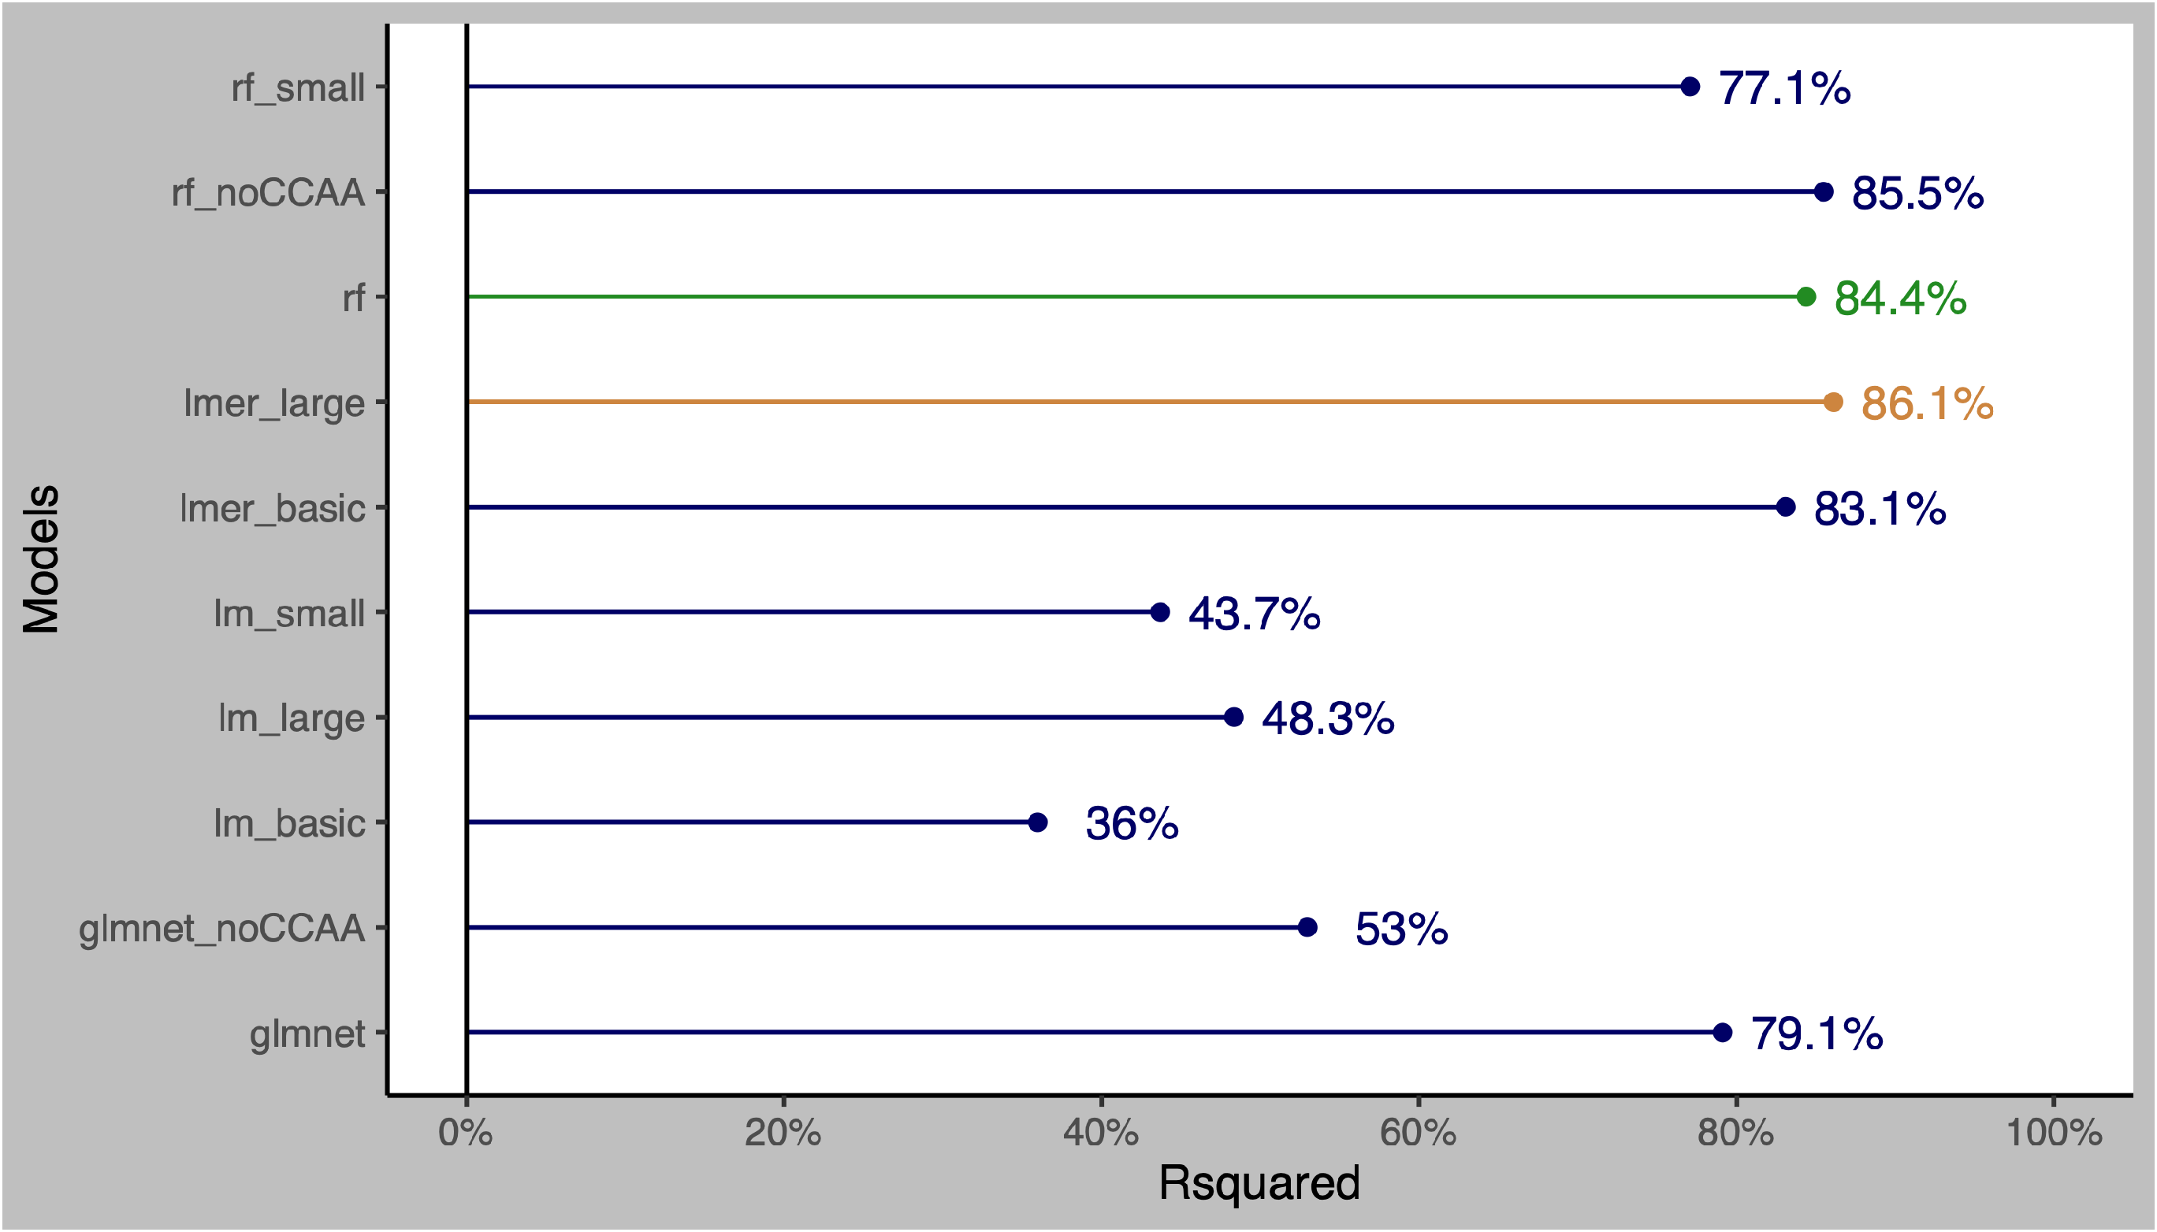
Best models were mixed-effects linear regression and random forest
Eric hausken-brates — July 2024

Slide 14
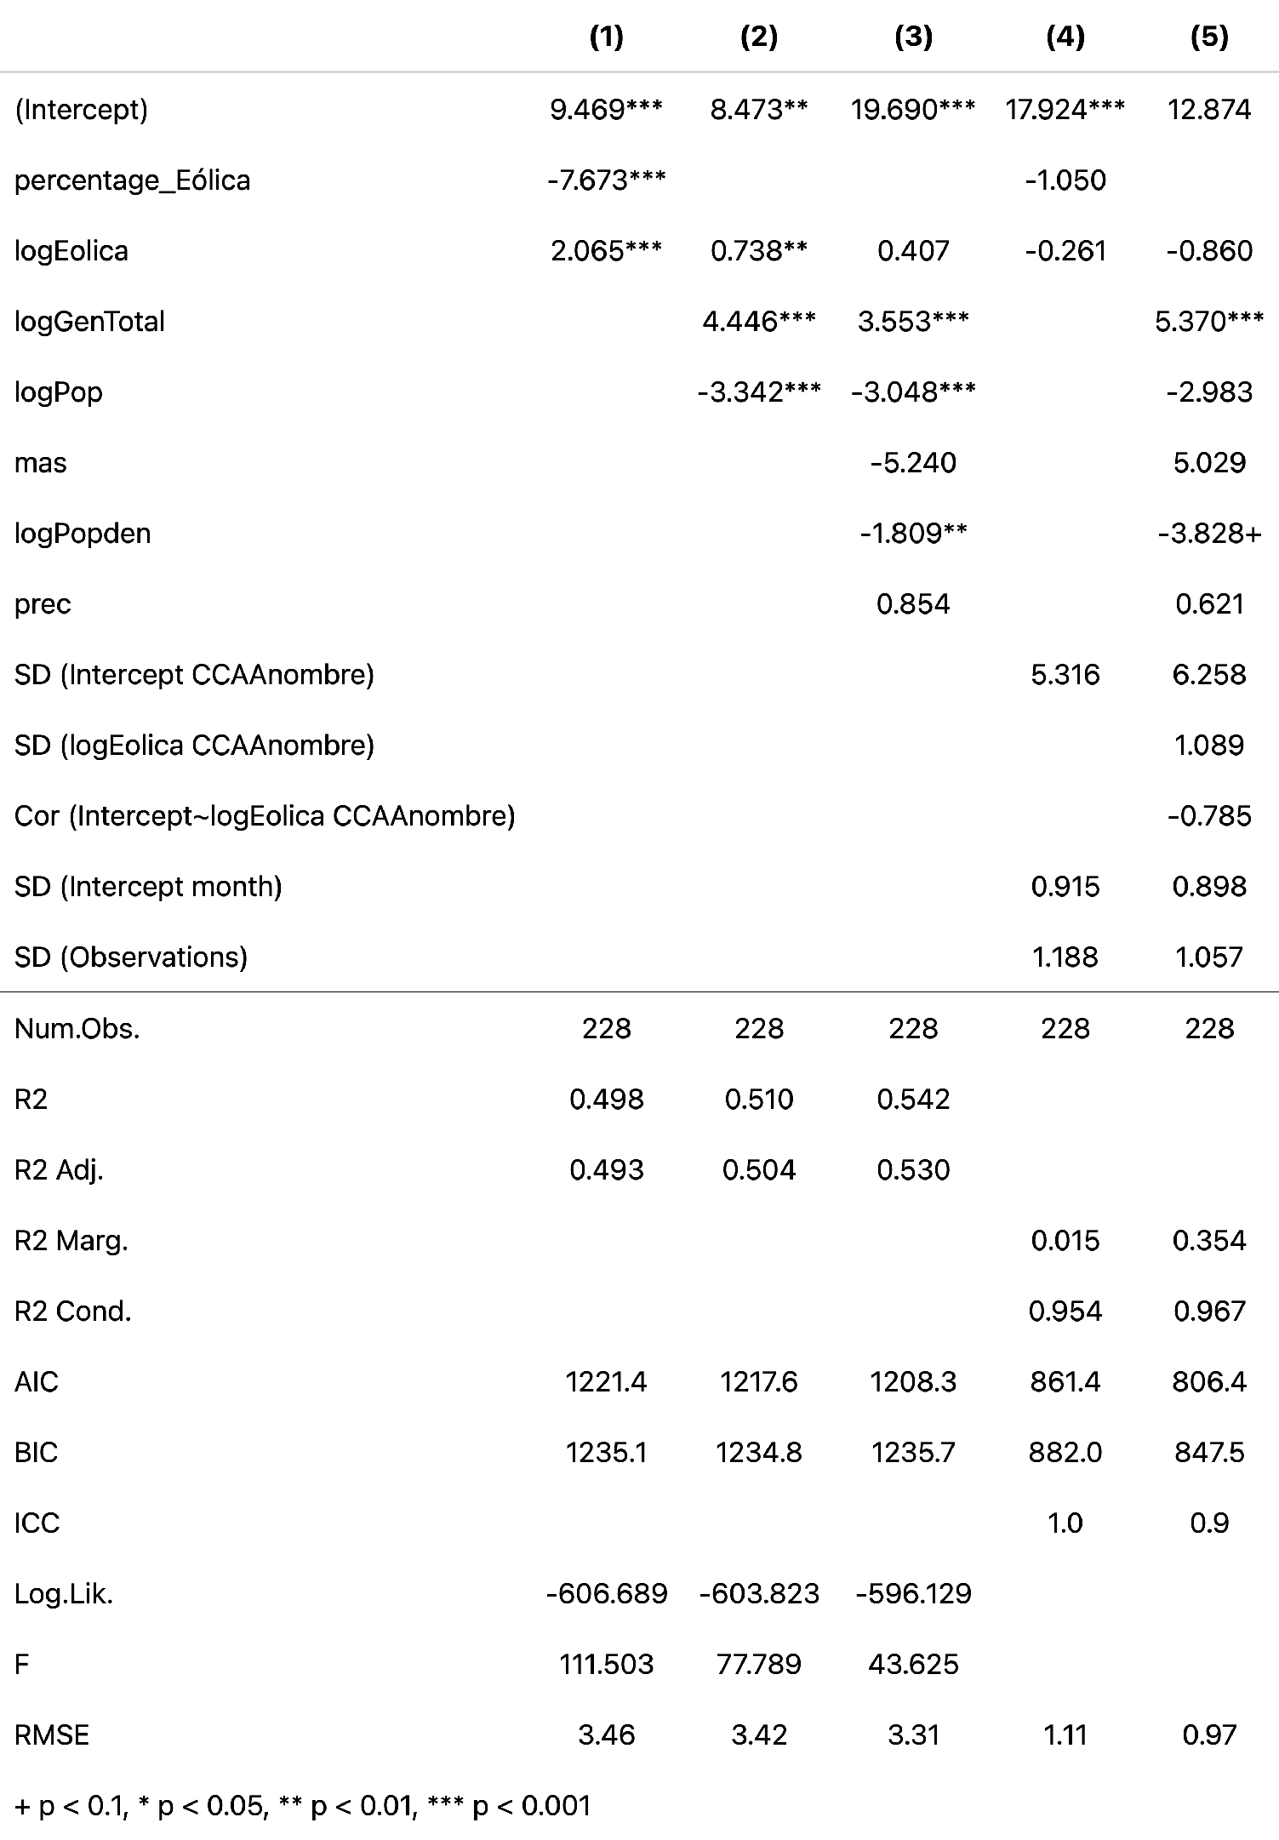
(5) mixed-effects linear regression
Eric hausken-brates — July 2024

Slide 15
Recommendations for Policymakers
Eric hausken-brates — July 2024
Avoid reports that aggregate regions together
Focus on Asturias
Hypothesis —> No clear that supports idea that more wind energy generation decreases EI
By Mussi Katz from Israel - 31 WInd turbines Spain, Public Domain,

Slide 16
Thank you!

Slide 17
Image credits
By Marta Esther Vázquez Fernández - Own work, CC BY-SA 4.0, https://commons.wikimedia.org/w/index.php?curid=120334286
By Jodok - Own work, CC0, https://commons.wikimedia.org/w/index.php?curid=141130990
By Mussi Katz from Israel - 31 WInd turbines Spain, Public Domain, https://commons.wikimedia.org/w/index.php?curid=130032607
By Impru20 - Own work, CC BY-SA 4.0, https://commons.wikimedia.org/w/index.php?curid=45016900

Slide 18
Works Cited
Cansino, J. M., Román-Collado, R., & Merchán, J. (2019). Do Spanish energy efficiency actions trigger JEVON’S paradox? Energy, 181, 760–770. https://doi.org/https: //doi.org/10.1016/j.energy.2019.05.210
Haas, C., & Kempa, K. (2018). Directed technical change and energy intensity dynamics: Structural change vs. energy efficiency. The Energy Journal, 39(4), 127–152. Retrieved June 18, 2024, from https://www.jstor.org/stable/26534462

